Slide 1
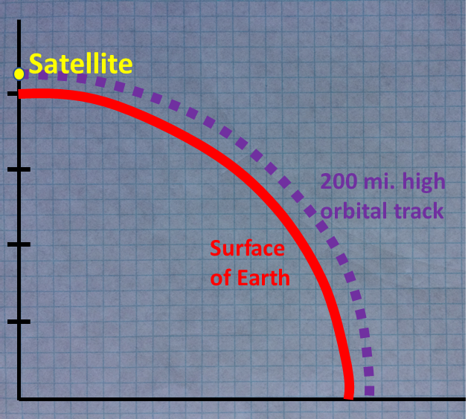
Orbits
Geometric and Centripetal Force Perspectives
LabRat Scientific
© 2018

Slide 2
There are two ways of thinking about orbits:
Geometric Perspective - An orbiting body continuously misses the earth as its falling towards the earth due to the object’s horizontal velocity and the curvature of the earth.
Centrifugal Force Perspective - The centrifugal force created by the object’s orbital velocity (which is actually a non-existent pseudo-force) exactly balances the inward force (a.k.a. weight) caused by earth’s gravity.

Slide 3
Basic Concepts to Keep in Mind
A satellite “orbits” the earth because of gravity. If there were no gravity, the satellite would simply fly off into space along a straight line.
The gravitational force exerted by one body on another is a function of the distance between the two objects. The greater the distance, the less the gravitational attraction.
The term “zero-G” used in conjunction with a vehicle in orbit is a misnomer. There is gravity in orbit, it’s just that everything is in “freefall” relative to everything else so everything just floats around like there is no gravity.
The term “freefall” used above implies that everything in orbit is falling. This is exactly correct… A satellite in orbit (and even the moon) is accelerating towards the center of the earth, but the horizontal orbital velocity keeps the satellite from ever hitting the earth.

Slide 4
This graph shows how the Acceleration due to Gravity (g) on earth changes with respect to orbital height above the surface of the earth.
Accel Due to Gravity (ft/sec²) = Gravitational Constant / ( Radius of Earth + Orbital Height )²
Accel Due to Gravity (ft/sec²) = 14.05 x 10¹⁵ ft³/sec² / ( 20,900,000 ft + Orbital Height in ft )²

Slide 5
Orbits from a Geometric Perspective
Orbital Parameters (Example):
Orbital Altitude is 200 nmi above the surface of the earth
Orbital velocity at that height is 25,200 ft/sec
Satellite
200 mi. high orbital track
Approach:
Using basic calculus, determine the time it takes the satellite to fall 200 miles straight down.
Use the “fall time” duration to calculate how far the satellite will travel in the horizontal direction due to its orbital velocity.
Plot the horizontal and vertical distances on graph paper to determine the orbital track
Surface of Earth

Slide 6
The Geometric Approach plots the horizontal and vertical displacements of the satellite on a scale diagram of the earth and orbit.
Satellite
Horizontal Component of the Satellite Motion
200 mi. high orbital track
Vertical Component of the Satellite Motion
Satellite track over the time interval
Surface of Earth
A time reference must be established so that the displacements (Displacement = Velocity x Time) can be calculated.
If we know how high the satellite is above the surface of the earth, we can calculate the time it would take the satellite to fall from that height to the ground. This time can then be used in conjunction with the orbital velocity to calculate how far the satellite would travel in the horizontal direction.

Slide 7
Since the fall time from 200 nmi will be used as the reference time in this example, the vertical displacement will always be 200 nmi.
Since the satellite’s orbital velocity is constant (we will assume a circular orbit), the horizontal displacement (= Fall Time x Orbital Velocity) will also be the same for each graphing step…
Horizontal Component = Fall Time x Orbital Velocity
Height of Orbit
(200 nmi)

Slide 8
Fall Time for the Satellite
The satellite accelerates towards the center of the earth due to gravity. From calculus, the area under the acceleration curve is velocity, and the area under the velocity curve is displacement. The mathematical process of “integration” is used to calculate these areas, ultimately allowing us to calculate the fall time.
Velocity = ʃ a dt = a ʃ t ⁰ dt
Velocity is the area under the acceleration curve. Distance is the area under the velocity curve.
Distance = ʃ Vel dt = ʃ a t¹ = a ʃ t¹
t ⁽¹⁺¹⁾
Distance = a * -----------
(1+1)
Distance = ½ a * t²
Recall your basic processes for analytical calculus…
See the LatRat Classroom Lesson on Mathematical Integration.

Slide 9
Fall Time for the Satellite
Algebra is applied to the distance equation in order to solve for Fall Time.
Distance = ½ Acceleration x Time²
Time = 2 x Distance / Acceleration
See the LatRat Classroom Lesson on Mathematical Integration.

Slide 10
Fall Time for the Satellite
Time = 2 x Distance / Acceleration
Distance (ft) = 200 mi x 6,080 ft/mi
Distance = 1,216,000 ft
Nautical miles are used in these calculations…
Acceleration (ft/sec²) = 32.2 ft/sec² at earth surface
Acceleration (ft/sec²) = 29.1 ft/sec² at 200 mi high
Average Acceleration = 30.65 ft/sec²
Acceleration due to Gravity decreases as the distance from the center of the earth increases…
Time = 2 x 1,216,000 ft / 30.7 ft/sec² = 281.5 sec

Slide 11
Horizontal Travel of the Satellite
If we multiply the fall time by the horizontal (orbital) velocity of the satellite, we can calculate how far the satellite will move in the horizontal direction during that reference time period.
Distance_{Horizontal} = Time x Velocity
Distance_{Horizontal} = 281.5 sec x 25,205 ft/sec
Distance_{Horizontal} = 7,095,208 ft
Distance_{Horizontal} = 1,167 nmi

Slide 12
How the satellite moves over the defined period of time
So, the satellite falls vertically 200 nmi. in 281.5 sec., but also moves 1,167 nmi. horizontally…
Horizontal Component of the Satellite Motion
(1,167 nmi)
Vertical Component of the Satellite Motion
(200 nmi)
Actual satellite track
This just represents a small segment to the flight path of the satellite. Many segments can be plotted on graph paper to construct the orbital path…

Slide 13
200 nmi x 200 nmi square
The horizontal and vertical distances are plotted on the graph…
Satellite
Dividing the 1,167 mile horizontal displacement by 200 squares/nmi yields 5.8 squares on the graph.
200 mi. high orbital track
Over the same time period, the satellite also falls 200 miles (1 square) towards the center of the earth.
Surface of Earth
So the satellite moves 1,167 nmi. horizontally and moves down 200 nmi. This places the satellite on the desired orbital track…
Radius of the earth is approx. 4,000 mi

Slide 14
200 nmi x 200 nmi square
If the graphing process is repeated, we see that the satellite stays on the desired 200 nmi. high orbital track.
Conclusion: The idea that the horizontal velocity of the satellite coupled with the curvature of the earth causes the satellite to continuously “miss the earth” as it falls is a reasonably valid explanation of how an orbit works…
Radius of the earth is approx. 4,000 mi

Slide 15
200 nmi x 200 nmi square
What would the diagram look like of the satellite were only travelling at 10,000 ft/sec?
Satellite
The horizontal distance travelled would be much less:
200 mi. high orbital track
Distance = 10,000 ft/sec x 281 sec
= 2,810,000 ft
= 462 nmi
= 2.3 squares
Surface of Earth
It is apparent from this exercise that the satellite will not track along the dashed purple line (the desired orbital track)…
Radius of the earth is approx. 4,000 mi

Slide 16
Orbits from a Centripetal Force Perspective
Centripetal Force:
The force that must be applied to an object in order to keep that object moving along a curved path (Example: the force on the string as you swing a tethered ball around your head).
F
Centrifugal Force:
The fictitious (or pseudo) outward force that appears to act on all objects that are following a curved path (Example: you feel that you are being thrown off a spinning merry-go-round). This is not a “real” force…
F

Slide 17
Orbits from a Centripetal Force Perspective
Centrifugal Force:
If the centripetal force is instantly eliminated the object will fling away along the tangent to the curved path (try it with a ball and string…). This proves there is no true “outward” radial force acting on the object – if there was, it would fly outward along a curved path.
F
However, since the “Centripetal Force” is pulling towards the center of rotation it “feels” as if there is an equal and opposite radial force acting outwards (think of the force as “tension” in a string where the force pulls on both end points…). As such, equating the pseudo “Centrifugal” Force to the Centripetal Force is commonly accepted.
F

Slide 18
Let’s look at a sample problem to see if the gravitational force is balanced by the “centrifugal” force when a satellite is orbiting the earth.
For this example, we will assume a 500 lb satellite is orbiting at an altitude of 200 nmi above the surface of the earth.
As in the geometric example, the orbital velocity is 25,205 ft/sec.

Slide 19
Orbits from a Centripetal Force Perspective
Equation for Centripetal Force:
F = mv²/r
v = Tangential Velocity
m = mass of the satellite
r = Radius of curvature
Mass = 500 lbs / 32.2 ft/sec²
= 15.5 lbs*sec²/ft
m = 15.5 slugs
The satellite weighs 500 lbs on the surface of the earth, so g = 32.2 ft/sec² is used to calculate the mass…
r = Radius of Earth + Orbital Height above Earth Surface
r = 20,900,000 ft + 1,216,000 ft
r = 22,116,000 ft

Slide 20
Orbits from a Centripetal Force Perspective
Centripetal Force:
F = mv²/r
F = ( 15.5 lbs*sec²/ft ) x (25,205 ft/sec) ² / 22,116,000 ft
F = 445 lbs
Gravitational Force:
F = Mass x g
To calculate the gravitational force in orbit we need to use the acceleration due to gravity at the 200 nmi orbital altitude ( g = 29.1 ft/sec² ).
F = 15.5 lbs*sec²/ft x 29.1 ft/sec²
F = 451 lbs

Slide 21
Orbits from a Centripetal Force Perspective
“Centrifugal” Force
Gravity Force
(Weight)
F
445 lbs
451 lbs
The differences in the numbers (~1%) are due to the use of approximated values and rounding off of numbers in the calculations.
For all intent and purposes, this shows that the gravitational force and centripetal force are balanced when a satellite is at the required orbital velocity.

Slide 22
CONCLUSION:
Both explanations describing why a satellite follows a curved orbital path are valid…

